Slide 1

AI App/ AI Quiz Generator
User Manual
Author: Ritika Bakkamanthala
Notes:
Preworks course home assignments

Slide 2
Acknowledgements
A small vote of thanks for all who have helped me in this journey of App Development – my parents, Ns. Mani,Dr. Ken Khan. None of this would have been possible without them.

Slide 3
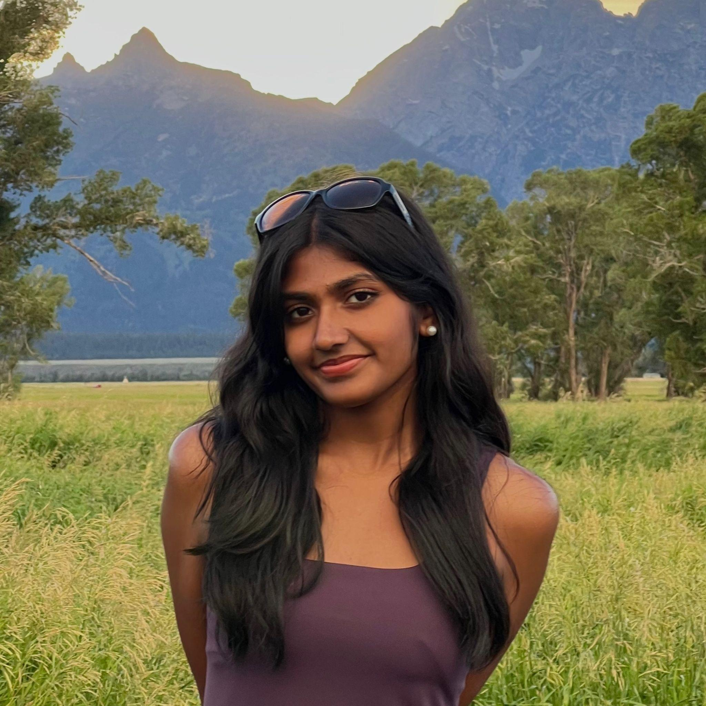
About Me..
I am Ritika Bakkamanthala, and I am currently in 11th grade. I’m from New Jersey, USA, and I am sixteen years old.

Slide 4
About My Internship Journey with Clevered..
I have been learning with Clevered for almost two years now, and I have already gained a proficient skill set with coding python using artificial intelligence. My journey with Clevered has been amazing and I look forward to see how I can grow in the future.

Slide 5
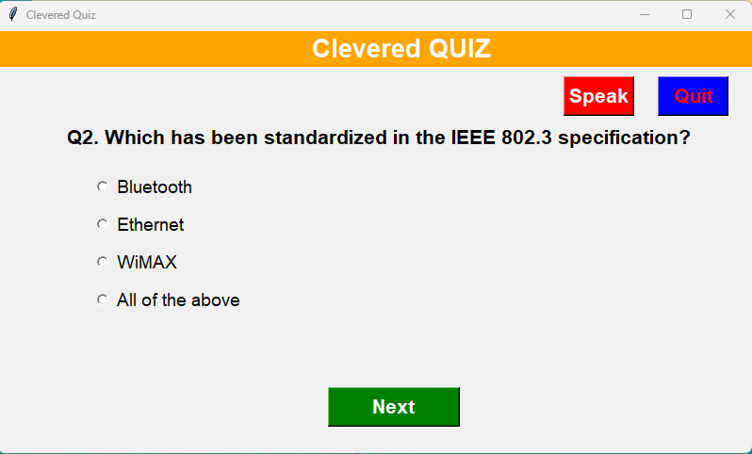
About App..
App’s Main Menu
App’s Introduction
The app uses AI to generate quizzes, and uses speech recognition.

Slide 6
How do I use the App?
Import tkinter, json, and pttsx3 libraries
When you run the project, it gives you the questions based on the json file in use
There is a “Speak” button that allows you to hear the question
There is a “Quit” button that allows you to exit the quiz
There is a “Next” button that allows you to move to the next question
There are radio buttons that allow you to select the answer

Slide 7
Option Name(This will be repeated for each option of the App)
Requires stable internet
Jupyter notebook
Or IDLE
Tkinter, json, and pttsx3 libraries

Slide 8
Demo Video
Demo any 2 features/ functions/ options of your project. Make a recording of the same and attach here as a backup if needed

Slide 9
Toolkit Walkthrough
Conduct 1 minute quick walkthrough of App Development Toolkit Workbook and LinkedIn and Github launch of the App. Attach links here for quick access.

Slide 10
Contact Person
Ritika Bakkamanthala
ritiikaaa@gmail.com

Slide 11
Thank you!

